Slide 1
Options Trading Competition
Week 4

Slide 2
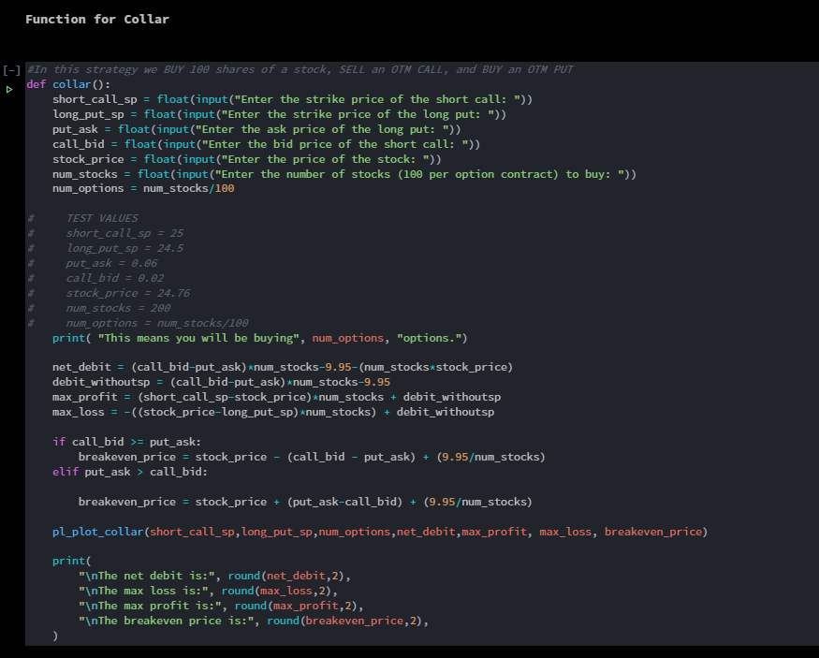
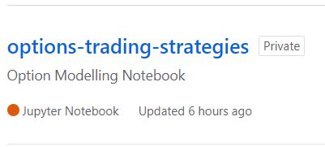
Update on the modelling notebook:
Added % you should win to Bull Call Spread and Bear Put Spread
Added Covered Call and Collar strategies
Total Strategies:
Bear Put Spread
Bull Call Spread
Long Straddle
Iron Condor
Covered Call
Collar
Created git repository to host notebook file
Work off master

Slide 3
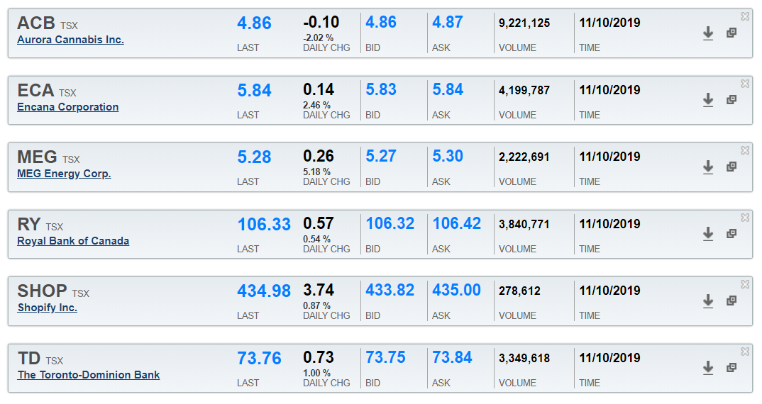
What Happened Last week:
Exercise and expiry of TD, SHOP, ECA, and RY bull call spreads.
A look at current position standings and current quotes:

Slide 4
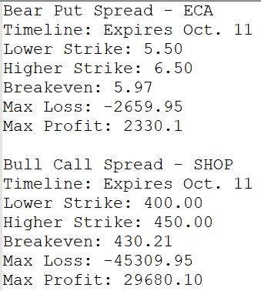
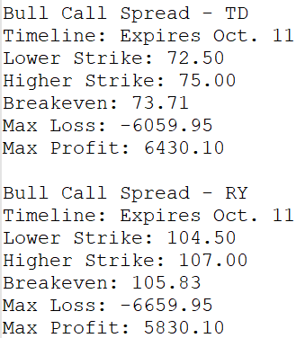
Refresher on OUR Positions from last week:
Notes:
Talk about if these were good decisions.

Slide 5
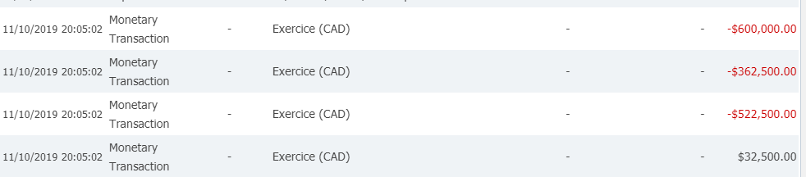
Options exercised
SHOP
TD
RY
ECA
All the ITM options were exercised
3 Calls for the Bull Call Spreads
1 Put for the Bear Put Spread

Slide 6
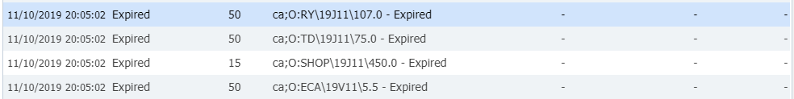
Options Expired
All the OTM options expired worthless
3 Calls for the Bull Call Spreads
1 Put for the Bear Put Spread

Slide 7
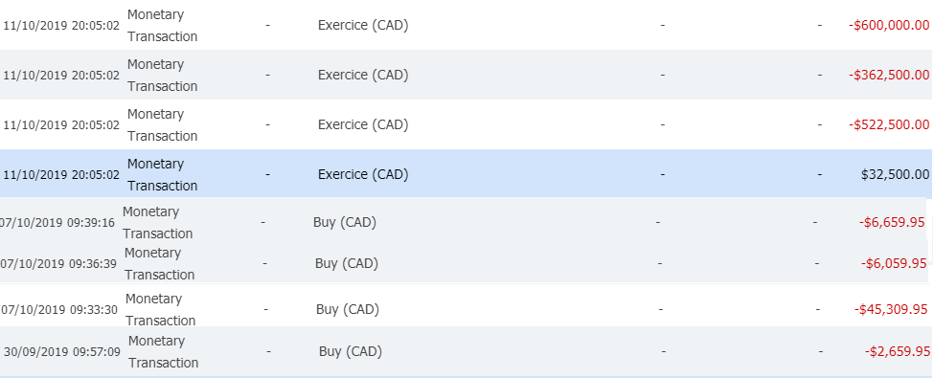
Considering cash flow
ECA: -2,659.95 + 32,500 = 29,840.05
SHOP: -45,309.95 – 600,000 = -645,309.95
TD: -6,059.95 - 362,500 = -368,559.95
RY: -6,659.95 – 522,500 = -529,159.95
= -1,513,189.80
How much did we profit???

Slide 8
Profit analysis
-5000 shares
1500 shares
5000 shares
5000 shares
ECA: -2,659.95 + 32,500 = 29,840.05 → Buy back for: $5.96 (or less)
SHOP: -45,309.95 – 600,000 = -645,309.95 → Sell for: $430.21 (or more)
TD: -6,059.95 - 362,500 = -368,559.95 → Sell for: $73.71 (or more)
RY: -6,659.95 – 522,500 = -529,159.95 → Sell for: $105.83 (or more)
0 = -1,513,189.80 + 1,513,189.80

Slide 9
Profit analysis
-5000 shares
1500 shares
5000 shares
5000 shares
ECA: -2,659.95 + 32,500 – 29,209.95= $630.10
SHOP: -45,309.95 – 600,000 + 650,730 = $5,420.05
TD: -6,059.95 - 362,500 + 368,740.05 = $180.10
RY: -6,659.95 – 522,500 + 531,590.05 = $2,430.1
= $8,660.35

Slide 10
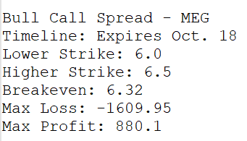
Current open positions
Worthless!

Slide 11

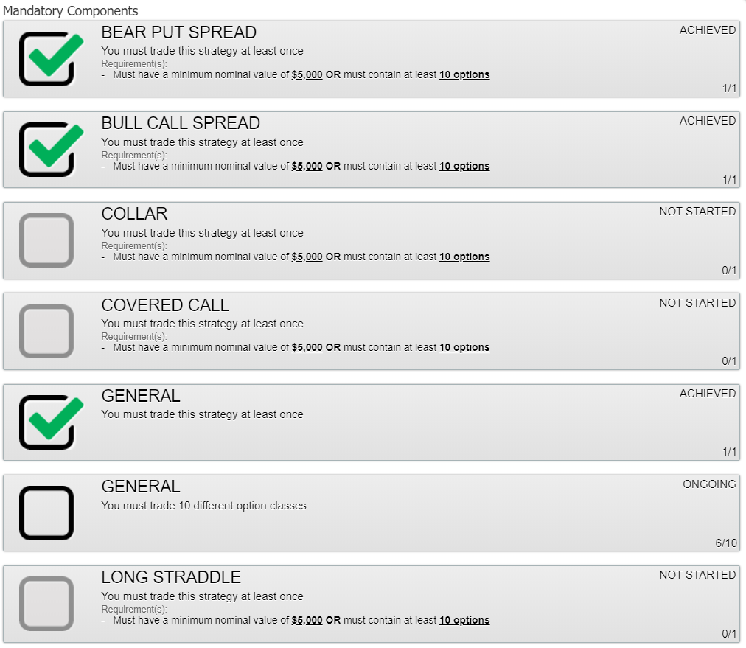
State of the mandatories
We still need to execute the following strategies:
Collar
Covered Call
Long Straddle
We still need to trade 2 different options
Anything except MEG, ACB, ECA, RY, TD, SHOP, CPG, and FM

Slide 12
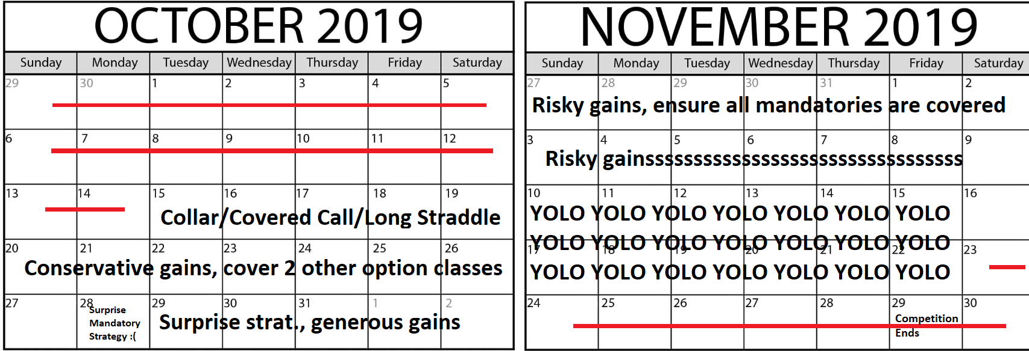
Competition timeline
What does conservative/generous/risky/yolo mean??????

Slide 13
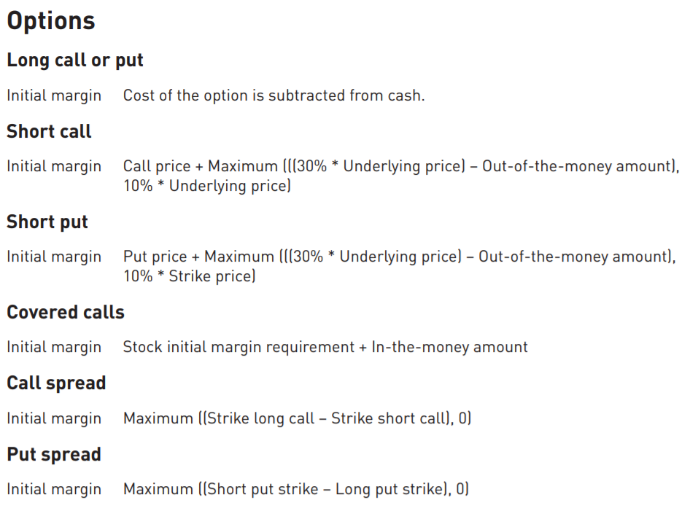
Margins
Any ideas?
Notes:
-We are going to have to focus on holding options positions until expiry.

Slide 14
Final thoughts and Key Takeaways:
Let’s decide on the trades for the Long Straddle, Covered Call, and Collar
I’m thinking we go bare minimum on each and just try to breakeven
Decide on some trades to make some gains?
Keep in mind our MEG trade is expiring this Friday.
Upload meeting slides?
Clearly defined risk taking for the remainder of the competition:
Conservative: Up to 25% risk
Generous: Up to 50% risk
Risky: Up to 75% risk
YOLO: Up to 100% risk
Notes:
Where should they be uploaded? Google drive? Facebook?

